Slide 1
JSP User Interface
Bernardo N. Yahya

Slide 2
Agenda
Form Processing
User Interface (text, password, button, radio button, check box, selection, text area)
Cookies
Session

Slide 3
Form Processing
You must have come across many situations when you need to pass some information from your browser to web server and ultimately to your backend program. The browser uses two methods to pass this information to web server. These methods are GET Method and POST Method.

Slide 4
GET method
The GET method sends the encoded user information appended to the page request. The page and the encoded information are separated by the ? character as follows:
http://www.test.com/hello?key1=value1&key2=value2
The GET method is the default method to pass information from browser to web server and it produces a long string that appears in your browser's Location:box. Never use the GET method if you have password or other sensitive information to pass to the server.
The GET method has size limitation: only 1024 characters can be in a request string.
This information is passed using QUERY_STRING header and will be accessible through QUERY_STRING environment variable which can be handled using getQueryString() and getParameter() methods of request object.

Slide 5
POST method
A generally more reliable method of passing information to a backend program is the POST method.
This method packages the information in exactly the same way as GET methods, but instead of sending it as a text string after a ? in the URL it sends it as a separate message. This message comes to the backend program in the form of the standard input which you can parse and use for your processing.
JSP handles this type of requests using getParameter() method to read simple parameters and getInputStream() method to read binary data stream coming from the client.

Slide 6
Reading Form Data using JSP
JSP handles form data parsing automatically using the following methods
depending on the situation:
Method | Description
getParameter() | You call request.getParameter() method to get the value of a form parameter.
getParameterValues() | Call this method if the parameter appears more than once and returns multiple values, for example checkbox.
getParameterNames() | Call this method if you want a complete list of all parameters in the current request.
getInputStream() | Call this method to read binary data stream coming from the client.

Slide 7
GET Method example using URL
GET Method
It will pass two values to other program using GET method
First, make a jsp file
Second, access it using a given URL

Slide 8
First Example
main.jsp
link
<html>
<head>
<title>Using GET Method to Read Form Data</title>
</head>
<body>
<center>
<h1>Using GET Method to Read Form Data</h1>
<ul>
<li><p><b>First Name:</b>
<%= request.getParameter("first_name")%>
</p></li>
<li><p><b>Last Name:</b>
<%= request.getParameter("last_name")%>
</p></li>
</ul>
</body>
</html>
http://localhost:8080/main.jsp?first_name=ZARA&last_name=ALI

Slide 9
GET Method example using Form
In this example, it will pass two values using HTML Form and submit button. We will use same main.jsp to handle this input.

Slide 10
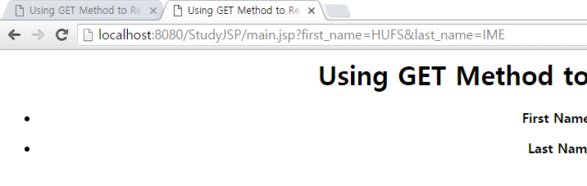
Second Example
main.jsp
Hello.html
<html>
<head>
<title>Using GET Method to Read Form Data</title>
</head>
<body>
<center>
<h1>Using GET Method to Read Form Data</h1>
<ul>
<li><p><b>First Name:</b>
<%= request.getParameter("first_name")%>
</p></li>
<li><p><b>Last Name:</b>
<%= request.getParameter("last_name")%>
</p></li>
</ul>
</body>
</html>
<html>
<body>
<form action="main.jsp" method="GET">
First Name: <input type="text" name="first_name">
<br />
Last Name: <input type="text" name="last_name" />
<input type="submit" value="Submit" />
</form>
</body>
</html>

Slide 11
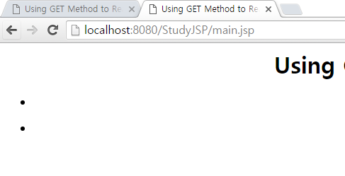
POST Method example using Form
main.jsp
Hello.html
<html>
<head>
<title>Using GET Method to Read Form Data</title>
</head>
<body>
<center>
<h1>Using GET Method to Read Form Data</h1>
<ul>
<li><p><b>First Name:</b>
<%= request.getParameter("first_name")%>
</p></li>
<li><p><b>Last Name:</b>
<%= request.getParameter("last_name")%>
</p></li>
</ul>
</body>
</html>
<html>
<body>
<form action="main.jsp" method="POST">
First Name: <input type="text" name="first_name">
<br />
Last Name: <input type="text" name="last_name" />
<input type="submit" value="Submit" />
</form>
</body>
</html>

Slide 12
GET vs POST
The following table compares the two HTTP methods: GET and POST.
 | GET | POST
BACK button/Reload | Harmless | Data will be re-submitted (the browser should alert the user that the data are about to be re-submitted)
Bookmarked | Can be bookmarked | Cannot be bookmarked
Cached | Can be cached | Not cached
Encoding type | application/x-www-form-urlencoded | application/x-www-form-urlencoded or multipart/form-data. Use multipart encoding for binary data
History | Parameters remain in browser history | Parameters are not saved in browser history
Restrictions on data length | Yes, when sending data, the GET method adds the data to the URL; and the length of a URL is limited (maximum URL length is 2048 characters) | No restrictions
Restrictions on data type | Only ASCII characters allowed | No restrictions. Binary data is also allowed
Security | GET is less secure compared to POST because data sent is part of the URL Never use GET when sending passwords or other sensitive information! | POST is a little safer than GET because the parameters are not stored in browser history or in web server logs
Visibility | Data is visible to everyone in the URL | Data is not displayed in the URL

Slide 13
Reading all form parameters
main.jsp
Hello.html
<%@ page import="java.io.*,java.util.*" %>
<html>
<head>
<title>HTTP Header Request Example</title>
</head>
<body>
<center>
<h2>HTTP Header Request Example</h2>
<table width="100%" border="1" align="center">
<tr bgcolor="#949494">
<th>Param Name</th><th>Param Value(s)</th>
</tr>
<%
Enumeration paramNames = request.getParameterNames();
while(paramNames.hasMoreElements()) {
String paramName = (String)paramNames.nextElement();
out.print("<tr><td>" + paramName + "</td>\n");
String paramValue = request.getParameter(paramName);
out.println("<td> " + paramValue + "</td></tr>\n");
}
%>
</table>
</center>
</body>
</html>
<html>
<body>
<form action="main.jsp" method="GET">
First Name: <input type="text" name="first_name">
<br />
Last Name: <input type="text" name="last_name" />
<input type="submit" value="Submit" />
</form>
</body>
</html>

Slide 14
POST Method Example Using Form with password
login.jsp
test2.jsp
<%@ page import="java.util.*" %>
<HTML>
<BODY>
<form name="form" method="post" action="test2.jsp">
<INPUT TYPE="text" NAME="id">
<INPUT TYPE="password" NAME="pw">
<INPUT TYPE="submit" value="OK">
</form>
</BODY>
</HTML>
<%@ page language="java" contentType="text/html; charset=euc-kr" %>
<%
request.setCharacterEncoding("euc-kr");
String id=request.getParameter("id");
String pw=request.getParameter("pw");
if(!"bernardo".equals(id))
{
out.println("ID is wrong");
}
if (!"hufs".equals(pw))
{
out.println("password is wrong");
}
if ("bernardo".equals(id) && "hufs".equals(pw))
{ %>
<ul>
<li><p><b>Welcome:</b>
<%= request.getParameter("id")%>
</p></li>
<li><p><b>You success to login.</b>
</p></li>
</ul> <%
}
%>

Slide 15
User Interface

Slide 16
User Interfaces (UI)
Main components of UI
Checkbox
RadioBox
Select Tag
ComboBox
TextArea

Slide 17
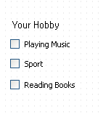
Checkbox
Checkboxes are used when more than one option is required to be selected.

Slide 18
CheckBox example
mainCheck.jsp
check.jsp
<html>
<body>
<form action="check.jsp" method="POST" target="_blank">
<h1>Your Hobby </h1>
<input type="checkbox" name="music" checked="checked" /> Playing Music
<input type="checkbox" name="sport" /> Sport
<input type="checkbox" name="book" checked="checked" /> Reading Books
<input type="submit" value="Select Subject" />
</form>
</body>
</html>
<html>
<head>
<title>Reading Checkbox Data</title>
</head>
<body>
<center>
<h1>Reading Checkbox Data</h1>
<ul>
<li><p><b>Music Flag:</b>
<%= request.getParameter("music")%>
</p></li>
<li><p><b>Sport Flag:</b>
<%= request.getParameter("sport")%>
</p></li>
<li><p><b>Book Flag:</b>
<%= request.getParameter("book")%>
</p></li>
</ul>
</body>
</html>

Slide 19
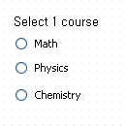
Radio
Radios are used when one should be selected among several options.

Slide 20
RadioBox example
mainRadio.html
radio.jsp
<html>
<body>
<form action="radio.jsp" method="POST" target="_blank">
<input type="radio" name="course" value="Maths"/> Maths
<input type="radio" name="course" value="Physics"/> Physics
<input type="radio" name="course" value="Chem"/> Chem
<input type="submit" value="Select Subject" />
</form>
</body>
</html>
<html>
<head>
<title>Reading Radio Data</title>
</head>
<body>
<center>
<h1>Reading Radio Data</h1>
The selected course is:
<%String crs=request.getParameter("course");
out.print(crs);
out.println(". Good luck..");
%>
</body>
</html>

Slide 21
SELECT TAG
It is to populate a dropdown box in the jsp page.
User can choose multiple selection from the list

Slide 22
SELECT TAG example
mainSelect.jsp
select.jsp
<html>
<head>
<title>
Example of SELECT Tag
</title>
</head>
<body>
<h2>SELECT TAG INPUT</h2>
<form method=post action=select.jsp>
<center>
<h4>Please choose your favourite nations...</h4>
<select name="national" multiple>
<option value="Korea">Korea
<option value="USA">USA
<option value="China">China
<option value="Australia">Australia
<option value="Japan">Japan
<option value="Brazil">Brazil
<option value="Indonesia">Indonesia
<option value="Germany">Germany
<option value="Others">Others
</select><p>
<input type=submit value=OK>
<input type=reset value="취소">
</center>
</form>
</body>
</html>
<html>
<head>
<title>
Example of SELECT Tag
</title>
</head>
<body>
<h2>SELECT TAG RESULT</h2>
<h4>This is your selection..</h4>
<%
String[] state=request.getParameterValues("national");
for(int i=0; i< state.length; i++) {
out.println(state[i]);
out.println("<br>");
}
%>
<p>Welcome to this class
</body>
</html>

Slide 23
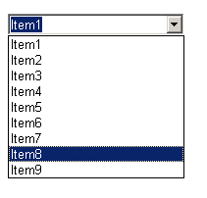
Combo Box
There is no such thing as a Combo box in HTML.
However, we can do selection using the dropdown (select element).

Slide 24
ComboBox example
mainCombo.jsp
combo.jsp
<html>
<head>
<title>The combo box (option) example</title>
</head>
<body>
<form name="form1" method="get" action="combo.jsp">
<select name="Events">
<option value="0" selected>(please select:)</option>
<option value="100M Run">100M Run</option>
<option value="200M Run">200M Run</option>
<option value="400M Run">400M Run</option>
<option value="800M Run">800M Run</option>
</select>
<input type="text" name="choicetext"></div>
<p align="center">
<input type="submit" name="Submit" value="Search">
</p>
<br><br><br><br><br><br><br><br><br><br><br>
</form>
</body>
</html>
<% String event = ((String)request.getParameter("Events"));
out.print(event);%>

Slide 25
Text Area
The <textarea> tag defines a multi-line text input control.
A text area can hold an unlimited number of characters, and the text renders in a fixed-width font (usually Courier).
The size of a text area can be specified by the cols and rows attributes, or even better; through CSS' height and width properties.

Slide 26
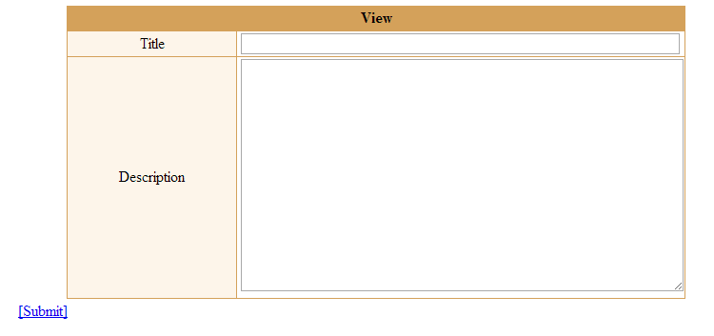
Problem. Make a text area based on the figure below.

Slide 27
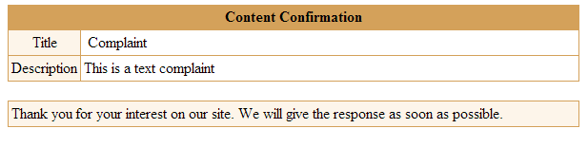
Content Confirmation

Slide 28
textarea.jsp
<HTML>
<HEAD>
<SCRIPT LANGUAGE="javascript">
function write()
{
form=document.write_form;
if (form.title.value == "")
{
alert("Please input the title.");
form.title.focus();
}
else if (form.content.value == "")
{
alert("Please input the description.");
document.write_form.content.focus();
}
else
{
document.write_form.submit();
}
}
</SCRIPT>
</HEAD>

Slide 29
textarea.jsp
<BODY>
<TABLE BORDER="0" WIDTH="650" CELLPADDING="0" CELLSPACING="0" ALIGN="CENTER">
<TR BGCOLOR="#D4A15A">
<TD COLSPAN=4>
<TABLE border=0 align=center><TR><TD>
<FONT COLOR="#000000">
<B>View</B></FONT>
</TD></TR></TABLE>
</td>
</TR>
</TABLE>

Slide 30
textarea.jsp
<TABLE BORDER="0" WIDTH="650" CELLPADDING="0" CELLSPACING="0" ALIGN="CENTER" BGCOLOR="#D4A15A">
<TR><TD>
<TABLE BORDER="0" WIDTH="650" CELLPADDING="0" CELLSPACING="1" ALIGN="CENTER">
<FORM NAME="write_form" METHOD="post" ACTION="textarea_view.jsp">
<TR>
<TD BGCOLOR="#FDF5EA" ALIGN="CENTER" width=60>Title</TD>
<TD BGCOLOR="#FFFFFF">&nbsp;<INPUT type="text" NAME="title" MAXLENGTH=100 STYLE="WIDTH:98%"></TD>
</TR>
<TR>
<TD BGCOLOR="#FDF5EA" ALIGN="CENTER">Description</TD>
<TD BGCOLOR="#FFFFFF">
&nbsp;<TEXTAREA NAME="content" ROWS="15" STYLE="WIDTH:99%"></TEXTAREA>
</TD>
</TR>
</FORM>
</TABLE></TD></TR>
</TABLE>
<TABLE width=650>
<TR><TD align=center>
<a href="javascript:write();">[Submit]</a>
</TD></TR>
</TABLE>
</BODY>
</HTML>

Slide 31
textarea_view.jsp
<HTML>
<HEAD>
</HEAD>
<%@ page language="java" import="java.util.*" %>
<%
String title=request.getParameter("title");
String content=request.getParameter("content");
%>
<BODY>
<TABLE BORDER="0" WIDTH="600" CELLPADDING="0" CELLSPACING="0" ALIGN="CENTER">
<TR BGCOLOR="#D4A15A">
<TD>
<TABLE border=0 align=center><TR><TD>
<FONT COLOR="#000000">
<B>Content Confirmation</B></FONT>
</TD></TR></TABLE>
</td>
</TR>
</TABLE>

Slide 32
textarea_view.jsp
<TABLE BORDER="0" WIDTH="600" CELLPADDING="0" CELLSPACING="0" ALIGN="CENTER" BGCOLOR="#D4A15A">
<TR><TD>
<TABLE BORDER="0" WIDTH="600" CELLPADDING="3" CELLSPACING="1" ALIGN="CENTER">
<TR>
<TD BGCOLOR="#FDF5EA" ALIGN="CENTER" width=60>Title</TD>
<TD BGCOLOR="#FFFFFF" width=540>&nbsp;<%=title%></TD>
</TR>
<TR>
<TD BGCOLOR="#FDF5EA" ALIGN="CENTER">Description</TD>
<TD BGCOLOR="#FFFFFF"><%=content%></TD>
</TR>
</TABLE></TD></TR>
</TABLE><br>
<TABLE BORDER="0" WIDTH="600" CELLPADDING="0" CELLSPACING="0" ALIGN="CENTER" BGCOLOR="#D4A15A">
<TR><TD>
<TABLE BORDER="0" WIDTH="600" CELLPADDING="3" CELLSPACING="1" ALIGN="CENTER">
<TR>
<TD BGCOLOR="#FDF5EA">Thank you for your interest on our site. We will give the response as soon as possible.
</TD>
</TR>
</TABLE></TD></TR>
</TABLE>
</BODY>
</HTML>

Slide 33
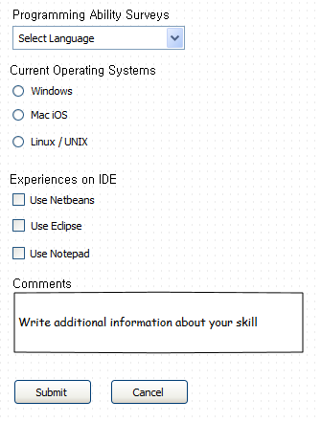
Practice
There are three options of languages;
Java, C#, C++.
After click “Submit”, we can see the result:
Programming Ability: Java
Current OS : Windows
Experiences on IDE : Netbeans, Eclipse
Comments: None

Slide 34
Cookies
Cookies are text files stored on the client computer and they are kept for various information tracking purpose. JSP transparently supports HTTP cookies using underlying servlet technology.
There are three steps involved in identifying returning users:
Server script sends a set of cookies to the browser. For example name, age, or identification number etc.
Browser stores this information on local machine for future use.
When next time browser sends any request to web server then it sends those cookies information to the server and server uses that information to identify the user or may be for some other purpose as well.
This chapter will teach you how to set or reset cookies, how to access them and how to delete them using JSP programs.

Slide 35
The Anatomy of a Cookie:
Cookies are usually set in an HTTP header (although JavaScript can also set a cookie directly on a browser). A JSP that sets a cookie might send headers that look something like this:
HTTP/1.1 200 OK
Date: Fri, 04 Feb 2000 21:03:38 GMT
Server: Apache/1.3.9 (UNIX) PHP/4.0b3
Set-Cookie: name=xyz; expires=Friday, 04-Feb-07 22:03:38 GMT;
path=/; domain=tutorialspoint.com
Connection: close
Content-Type: text/html
Cookies Folder for Google Chrome:
C:\Users\your_username\AppData\Local\Google\Chrome\User Data\Default\

Slide 36
Setting Cookies with JSP
(1) Creating a Cookie object: You call the Cookie constructor with a cookie name and a cookie value, both of which are strings.
Cookie cookie = new Cookie("key","value");
(2) Setting the maximum age: You use setMaxAge to specify how long (in seconds) the cookie should be valid. Following would set up a cookie for 24 hours.
cookie.setMaxAge(60*60*24);
(3) Sending the Cookie into the HTTP response headers: You use response.addCookie to add cookies in the HTTP response header as follows:
response.addCookie(cookie);

Slide 37
Cookies Example
mainCookies.jsp
cookies.jsp
<%
// Create cookies for first and last names.
Cookie firstName = new Cookie("first_name",
request.getParameter("first_name"));
Cookie lastName = new Cookie("last_name",
request.getParameter("last_name"));
// Set expiry date after 24 Hrs for both the cookies.
firstName.setMaxAge(60*60*24);
lastName.setMaxAge(60*60*24);
// Add both the cookies in the response header.
response.addCookie( firstName );
response.addCookie( lastName );
%>
<html>
<head>
<title>Setting Cookies</title>
</head>
<body>
<center>
<h1>Setting Cookies</h1>
</center>
<ul>
<li><p><b>First Name:</b>
<%= request.getParameter("first_name")%>
</p></li>
<li><p><b>Last Name:</b>
<%= request.getParameter("last_name")%>
</p></li>
</ul>
</body>
</html>
<html>
<body>
<form action="mainCookies.jsp" method="GET">
First Name: <input type="text" name="first_name">
<br />
Last Name: <input type="text" name="last_name" />
<input type="submit" value="Submit" />
</form>
</body>
</html>

Slide 38
Delete Cookies
To delete cookies is very simple. If you want to delete a cookie then you simply need to follow up following three steps:
Read an already existing cookie and store it in Cookie object.
Set cookie age as zero using setMaxAge() method to delete an existing cookie.
Add this cookie back into response header.

Slide 39
deleteCookies.jsp
<html>
<head>
<title>Reading Cookies</title>
</head>
<body>
<center>
<h1>Reading Cookies</h1>
</center>
<%
Cookie cookie = null;
Cookie[] cookies = null;
// Get an array of Cookies associated with this domain
cookies = request.getCookies();
if( cookies != null ){
out.println("<h2> Found Cookies Name and Value</h2>");
for (int i = 0; i < cookies.length; i++){
cookie = cookies[i];
if((cookie.getName( )).compareTo("first_name") == 0 ){
cookie.setMaxAge(0);
response.addCookie(cookie);
out.print("Deleted cookie: " +
cookie.getName( ) + "<br/>");
}
out.print("Name : " + cookie.getName( ) + ", ");
out.print("Value: " + cookie.getValue( )+" <br/>");
}
}else{
out.println(
"<h2>No cookies founds</h2>");
}
%>
</body>
</html>

Slide 40
Session
A session is an object associated with a visitor. Data can be put in the session and retrieved from it, much like a Hashtable. A different set of data is kept for each visitor to the site.

Slide 41
Summary of Session Method
S.N. | Method & Description
1 | public Object getAttribute(String name) This method returns the object bound with the specified name in this session, or null if no object is bound under the name.
2 | public Enumeration getAttributeNames() This method returns an Enumeration of String objects containing the names of all the objects bound to this session.
3 | public long getCreationTime() This method returns the time when this session was created, measured in milliseconds since midnight January 1, 1970 GMT.
4 | public String getId() This method returns a string containing the unique identifier assigned to this session.
5 | public long getLastAccessedTime() This method returns the last time the client sent a request associated with this session, as the number of milliseconds since midnight January 1, 1970 GMT.
6 | public int getMaxInactiveInterval() This method returns the maximum time interval, in seconds, that the servlet container will keep this session open between client accesses.
7 | public void invalidate() This method invalidates this session and unbinds any objects bound to it.
8 | public boolean isNew( This method returns true if the client does not yet know about the session or if the client chooses not to join the session.
9 | public void removeAttribute(String name) This method removes the object bound with the specified name from this session.
10 | public void setAttribute(String name, Object value) This method binds an object to this session, using the name specified.
11 | public void setMaxInactiveInterval(int interval) This method specifies the time, in seconds, between client requests before the servlet container will invalidate this session.

Slide 42
Session Example (1)
GetName.html
SaveName.jsp
<HTML>
<BODY>
<FORM METHOD=POST ACTION="SaveName.jsp">
What's your name? <INPUT TYPE=TEXT NAME=username SIZE=20>
<P><INPUT TYPE=SUBMIT>
</FORM>
</BODY>
</HTML>
<%
String name = request.getParameter( "username" );
session.setAttribute( "theName", name );
%>
<HTML>
<BODY>
<A HREF="NextPage.jsp">Continue</A>
</BODY>
</HTML>

Slide 43
Session Example (1)
NextPage.jsp
<HTML>
<BODY> Hello, <%= session.getAttribute( "theName" ) %>
</BODY> </HTML>

Slide 44
Session Example (2)
The next example describes how to use the HttpSession object to find out the creation time and the last-accessed time for a session.

Slide 45
sessionEx.jsp
<%@ page import="java.io.*,java.util.*" %>
<%
// Get session creation time.
Date createTime = new Date(session.getCreationTime());
// Get last access time of this web page.
Date lastAccessTime = new Date(session.getLastAccessedTime());
String title = "Welcome Back to my website";
Integer visitCount = new Integer(0);
String visitCountKey = new String("visitCount");
String userIDKey = new String("userID");
String userID = new String("ABCD");
// Check if this is new comer on your web page.
if (session.isNew()){
title = "Welcome to my website";
session.setAttribute(userIDKey, userID);
session.setAttribute(visitCountKey, visitCount);
}
visitCount = (Integer)session.getAttribute(visitCountKey);
visitCount = visitCount + 1;
userID = (String)session.getAttribute(userIDKey);
session.setAttribute(visitCountKey, visitCount);
%>
<html>
<head>
<title>Session Tracking</title>
</head>
<body>
<center>
<h1>Session Tracking</h1>
</center>
<table border="1" align="center">
<tr bgcolor="#949494">
<th>Session info</th>
<th>Value</th>
</tr>
<tr>
<td>id</td>
<td><% out.print( session.getId()); %></td>
</tr>
<tr>
<td>Creation Time</td>
<td><% out.print(createTime); %></td>
</tr>
<tr>
<td>Time of Last Access</td>
<td><% out.print(lastAccessTime); %></td>
</tr>
<tr>
<td>User ID</td>
<td><% out.print(userID); %></td>
</tr>
<tr>
<td>Number of visits</td>
<td><% out.print(visitCount); %></td>
</tr>
</table>
</body>
</html>

Slide 46
Summary
GET and POST method
User Interfaces
Cookies
Session

